Slide 1
Module 10: Build chatbots with Power Virtual Agents

Slide 2
Power Virtual Agents
Create chatbots and topics
Automate and integrate
Test, publish, share

Slide 3

Before you start creating bots, it is important to consider what the bot will be used for.

Slide 4
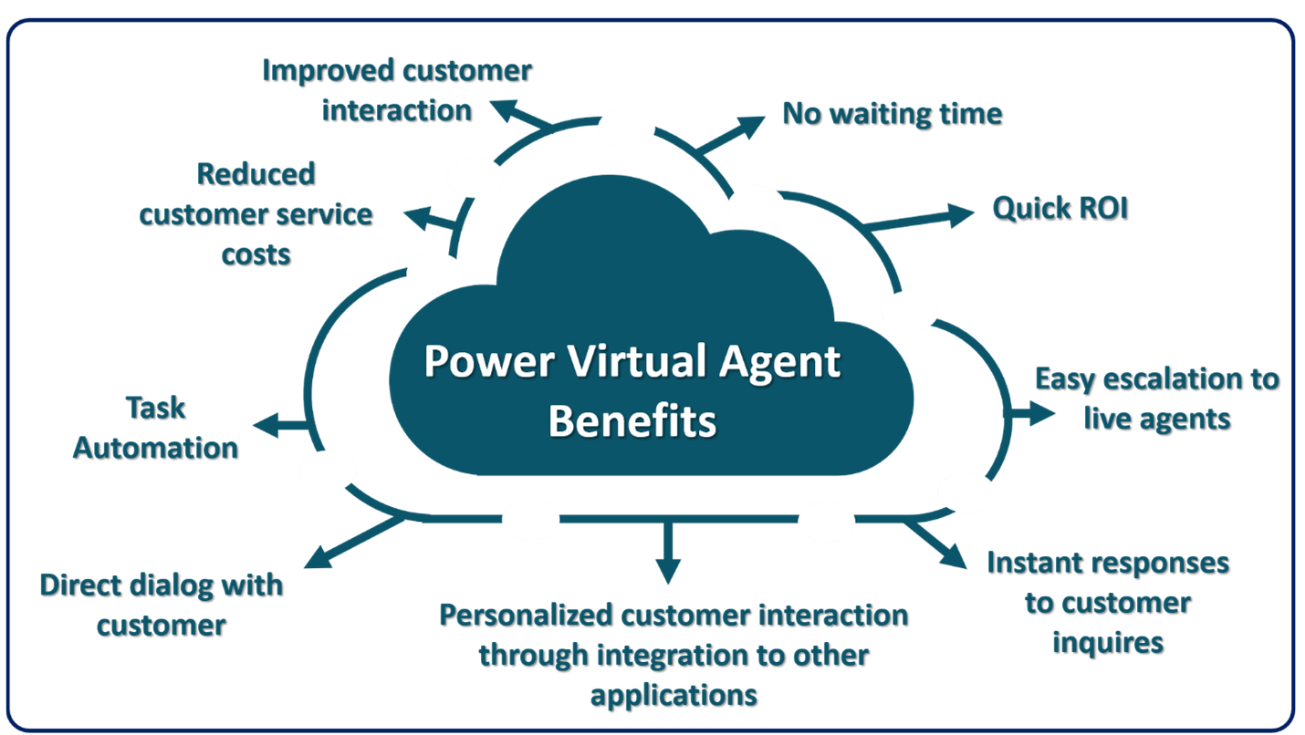
Introduction to Power Virtual Agents
Reduce assisted support inquiries
Integrate seamlessly with other systems
Task automation

Slide 5
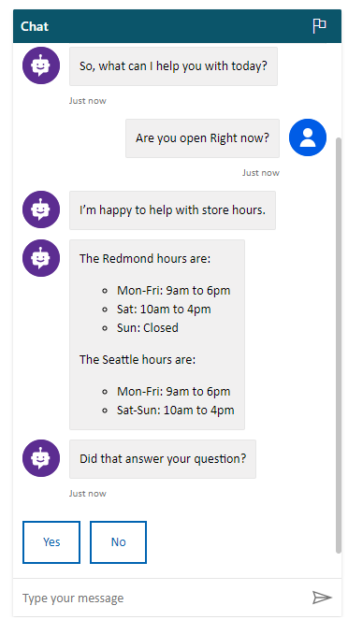
Power Virtual Agents
Quick Deployment
Empower SMEs
Bots can be created and embed it into your website with just a few clicks.
Subject Matter Experts SMEs can create bots quickly and easily using an intuitive, code-free graphical interface.
Natural conversations
Take action
End users to have rich multi-turn conversations which quickly guide them to the right solution with no need to re-train AI models.
Take actions to resolve customer issues with easy integration with services and back-end systems through hundreds of easy-to-add custom connectors using Power Automate.
Better together
Monitor and improve bot performance
Virtual Agent for Customer Service works hand-in-hand with Dynamics 365 for Customer Service Insights to provide a holistic view of your customer service operations.
Easily see which topics are doing well, where the bot can improve, and quickly adjust and improve performance.

Slide 6
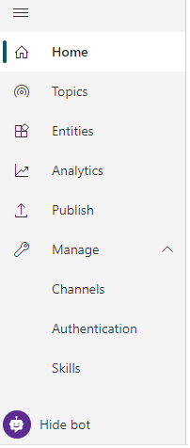
Power Virtual Agent UI Overview
Topics
Entities
Define how conversations with the bot will play out.
Represent a type of real-world subject. Ex. Phone Number, Zip Code, etc.
Analytics
Publish
Provides statistics related to your bot such as number of sessions, customer satisfaction, etc.
Provides tools and options to assist in publishing and sharing your bot.
Manage
Test/Hide Bot
Helps manage channels, authentication, and skills associated with your bot.
Toggles the bot test panel.

Slide 7
How can you enhance bots?
Initiate Microsoft Power Automate cloud flows - You can initiate Power Automate cloud flows directly from topics in your bot. This feature allows you to include personalized information for other services in the message content that is being provided.
Pass conversations to live agents - Bots can be configured to pass conversations, including the context of the conversation, to applications such as Omnichannel for Microsoft Dynamics 365 Customer Service, where live agents can take over the task of working on the conversation.
Automate topic creation - You can extract content from existing support pages, such as Frequently Asked Questions (FAQs), and then convert it into bot topics that can be used in conversations. Topics can also be created from topics that are suggested in Microsoft Dynamics 365 Customer Service Insights.

Slide 8

Demo

Slide 9
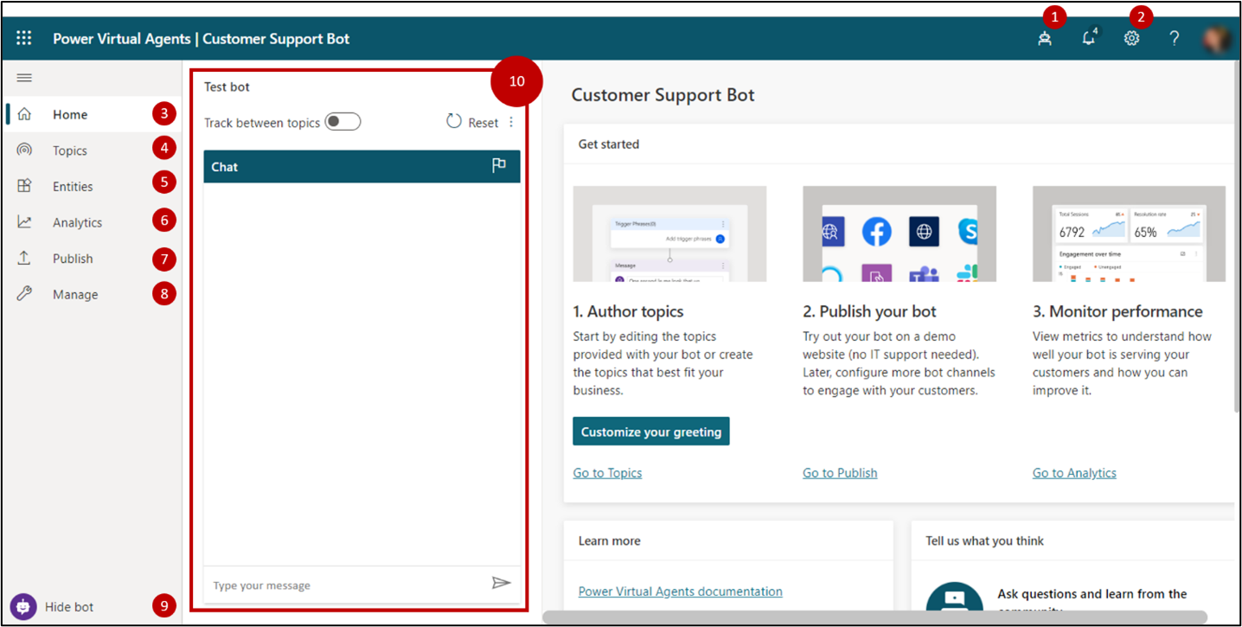
Create a bot in the PVA interface
Bots Panel
Settings
Home
Topics
Entities
Analytics
Publish
Manage
Test/Hide bot
Test bot panel

Slide 10



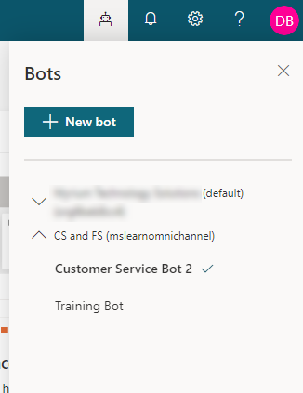
Environments
Bots can be created in different environments across your tenant
Environments must be created first. (https://admin.powerplatform.Microsoft.com)
Bots across all environments can be accessed from the Bots panel.
Selecting a bot will open that Bot in the UI
New bots can be created directly from the Bots Panel
* Must have appropriate permissions to environment. (Bot Author Role)

Slide 11
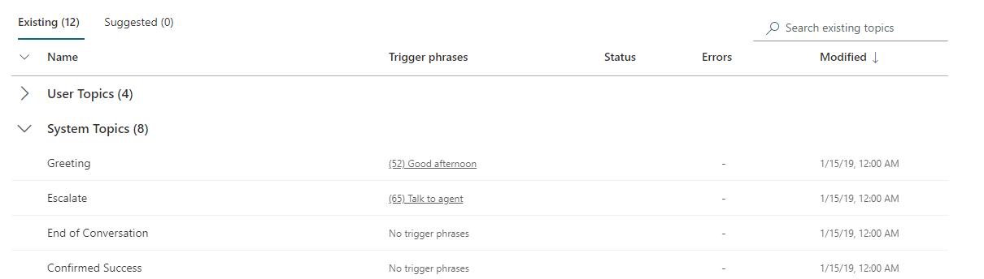
Topics
Topics are conversation paths that can be tied together in a single bot
Each Topic has trigger phrases that control when the topic is used.
Topics can be turned on or off.
Multiple system topics created automatically to assist in handling items such as greetings, escalations, etc.

Slide 12
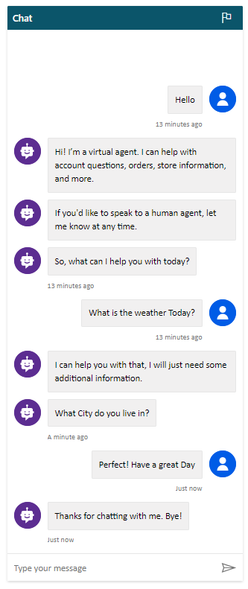



Leveraging Topics
Greeting
Check Weather
Goodbye
Trigger:
Hello
Message 1:
Hi I’m a Virtual Agent.
Message 2:
How can I help you?
Trigger:
What is the weather today?
Message:
I can help you with that.
Question:
What city do you live in?
Trigger:
Perfect! Have a great day
Message:
Thanks for chatting with me. Bye!
By including multiple topics, users are provided with a tailored conversation based on the text they enter into the conversation

Slide 13
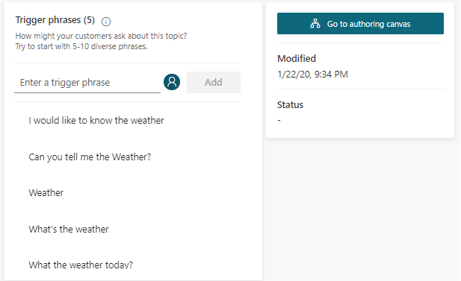
Defining Topics
Topics contain two options for modifying how the topic functions
Trigger Phrases
Authoring Canvas
Defines what words a user could type in to initiate the topic in the conversation.
Used to construct the conversation path that will be used as users' interface with the topic.
Triggers are not required if the topic will be triggered in other ways.

Slide 14
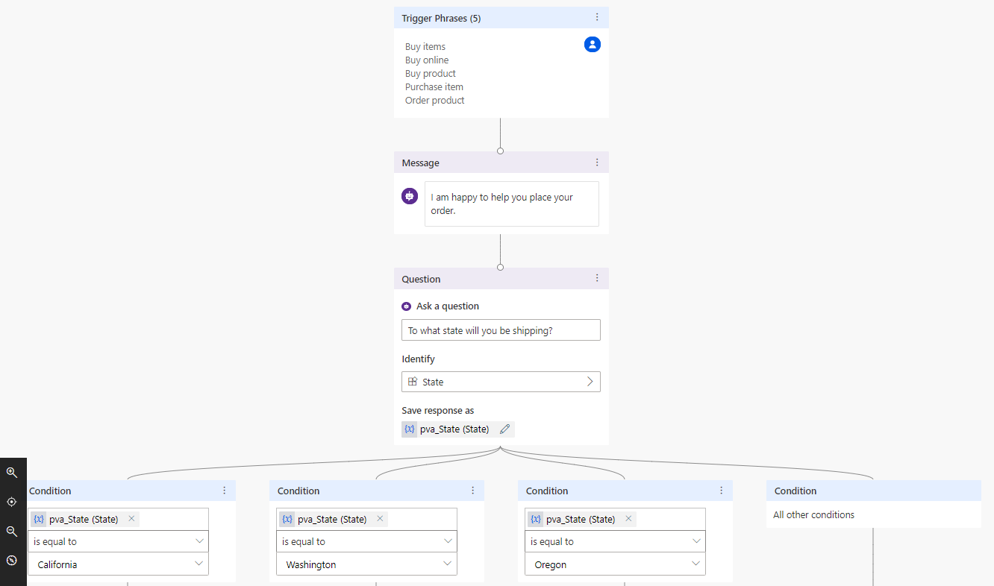
Topic Authoring Canvas

Slide 15





Designing a Topic Conversation Path
Ask a question
Call an action
Show a message
Go to another topic
End the conversation
Captures variables used in the bot.
Executes an action such as a Power Automate Flow.
Displays a message in the conversation window.
Automatically moves to a different topic.
Ends the conversation with the user.

Slide 16
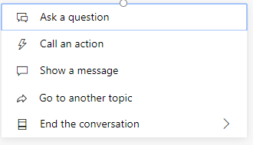
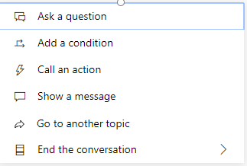
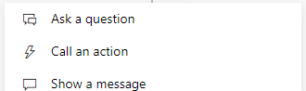
Which Nodes are available?
Available nodes when added at the end.
Available when added after a question node.
Available nodes when added between existing nodes.

Slide 17
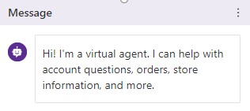
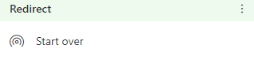
Message nodes
Go to another topic nodes
Define a message the bot will display to a user.
Each message will be represented as a different message in the conversation.
No data is captured from a message in the conversation.
Variables captured in other steps can be included in the message.
Directs the conversation to a different topic.
Used when another topic should be automatically leveraged rather than relying on a trigger

Slide 18
Question Nodes
Used to capture variables that can be used throughout the conversation.
A question node includes the following
Question: Defines the question text that should be communicated to the user.
Identify: Define the type on information that you want to capture from the user.
(Ex. URL, City, weight, pick list, etc.)
Can leverage existing pre-defined entities in the bot for the information.
Each bot includes several pre-built entities available.
Based on they type of information being collected, remaining question configuration options will be based on what you select for the Identify option.

Slide 19
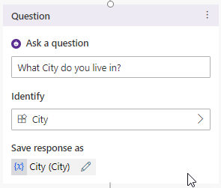
Variables
Save response as will store the information collected in the question as a variable that can be leveraged later in the bot.
Variables are store in entities:
The entity type will be based on what was selected in the Identify Field
The Variable will contain a default name
The Variable name should be changed to something more easily identifiable for the question.
* The Variable name is extremely important in scenarios where the bot will be evoking Power Automate Flows.

Slide 20
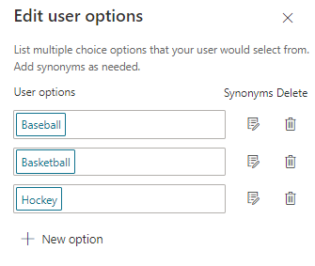
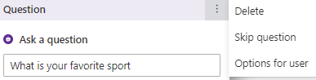
Multiple Choice Questions
Allows users to select a response from a predefined list
Users can also type there answer into the bot.
Users are directed down different paths based on their answer.
Improving Option Accuracy
Synonyms can be added for each option to ensure the correct option is selected even if the user does not type it exactly as the options is defined.
Synonyms can be added by selecting Options for user on the Question header.

Slide 21
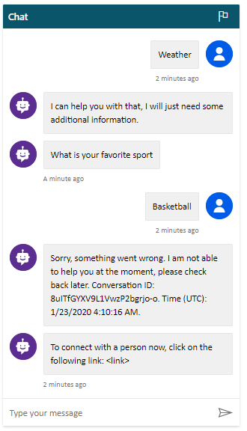
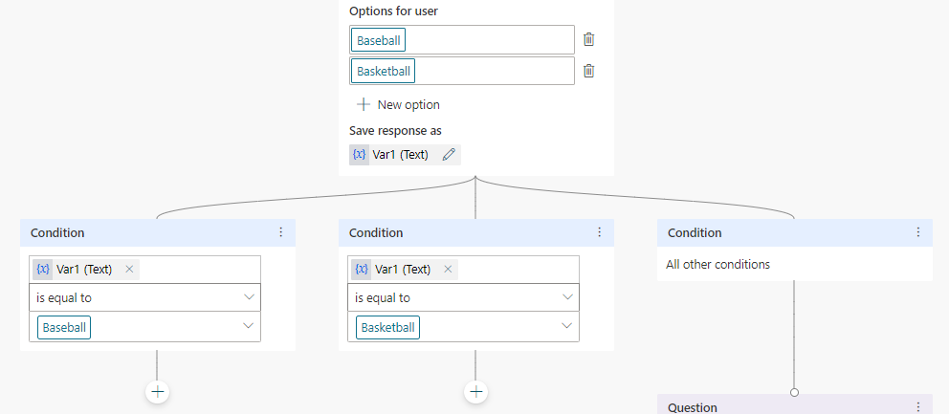
Multiple Choice Conditions
Conditions are added for each option that can be selected in a multiple-choice question.
A node must be defined for each to ensure the bot knows what to do when the option is selected.
Not defining a node results in the bot displaying an error in the conversation window. (The condition can be deleted if no direction is required).

Slide 22



End the Conversation
Provides options for ending the conversation
Two options available:
End with Survey
Transfer to Agent:
Send the conversation to a live agent, along with a message from the conversation.
The bot must be configured to know where to send the conversation when the option is selected

Slide 23
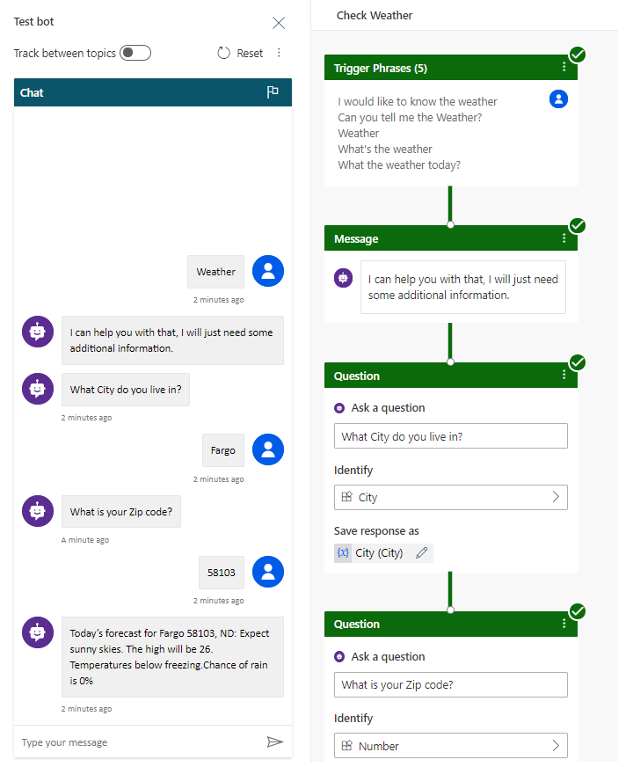
Testing your bot
Bots can be tested during the design process using the Test Bot panel.
The Test your bot button displays the Test Bot panel
All Topics will be available during the test.
Individual Nodes will indicate a success or failure as tested.
IMPORTANT: You must save a Topic before testing to ensure the latest changes are included in the test.

Slide 24
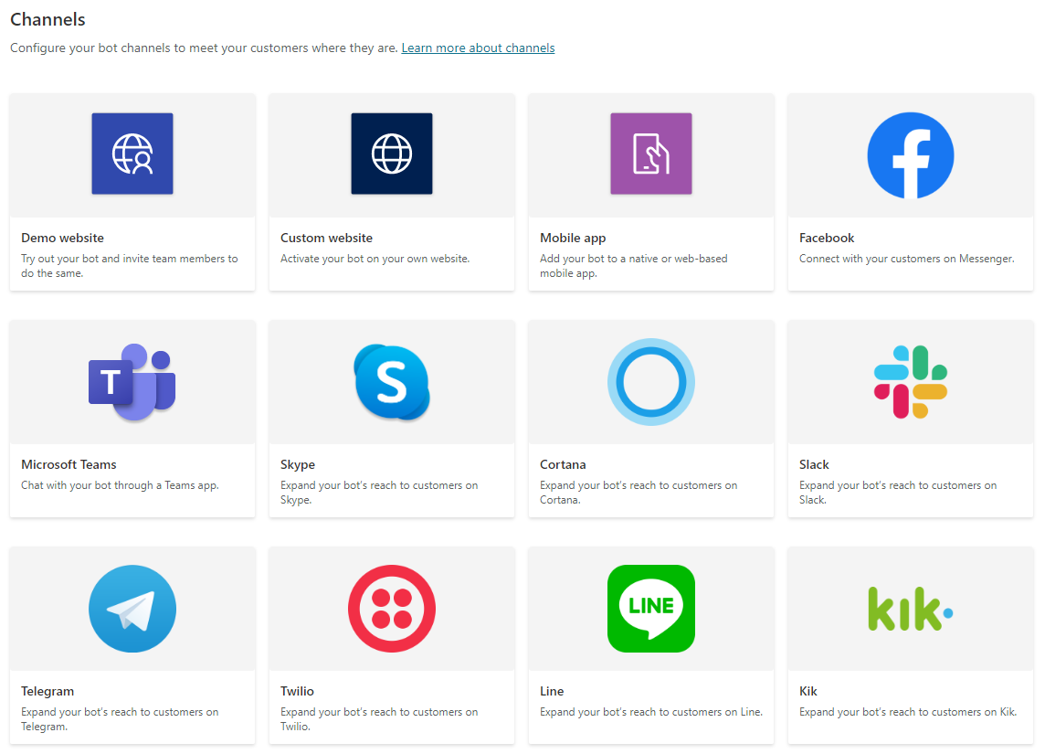
Publishing
Once you have completed and tested your bot, you will need to publish it before it will be live.
Bots can be configured to be leveraged with multiple channels.
Each channel will need to be independently configured.
Note: If you configure the bot to work with Omnichannel for CS it will automatically be leveraged when an item it routed to the queue the bot is associated with. (More Later)

Slide 25




Types of Errors
There are four types or errors that appear in the Topic Checker:
Node
Field
Expression
Variable deletion
The entire node is erroneous and is highlighted red.
The field might be missing required data and is highlighted red.
The expression might be invalid and is highlighted red.
A variable in a topic was deleted and is highlighted red wherever it was used. This causes the variable to become "orphaned", and it must be either removed or replaced.

Slide 26

Topic Status
Topics can have a status of On or Off:
When a topic is On
It will trigger as expected, either as a result of its trigger phrases or when it is redirected to from another topic.
Most of your topics are likely to be in the On state.
It will not trigger at all.
The topics trigger phrases are used in a bot conversation
It is as if the topic doesn't exist.
It will not be redirected to, even if another topic has specified that it should be.
When a topic is Off:
All topics (On or Off) will be published, but the Off topics will not trigger.
The topics will also not trigger on the channels that the bot is published to, and the topics will not trigger in the test bot.

Slide 27
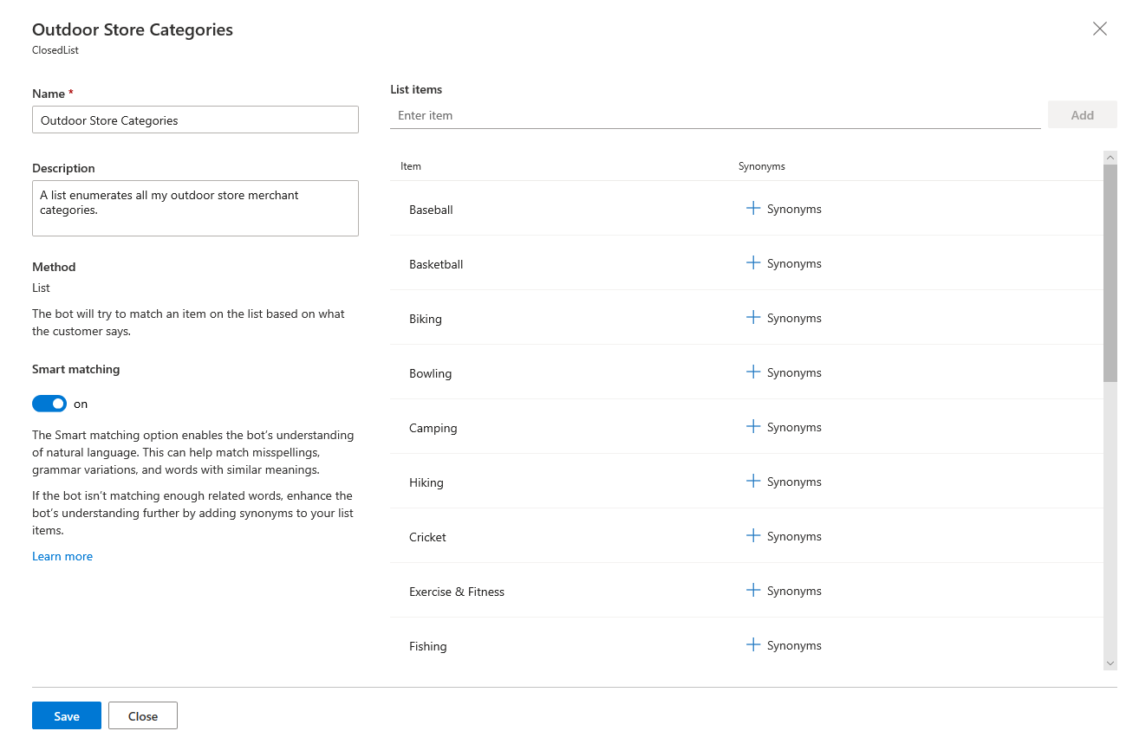
Custom Entities
Used to teach the bot’s language understanding model domain-specific knowledge.
Can be created from existing content.
Synonyms can be added for each item defined in the entity to improve the Models accuracy

Slide 28
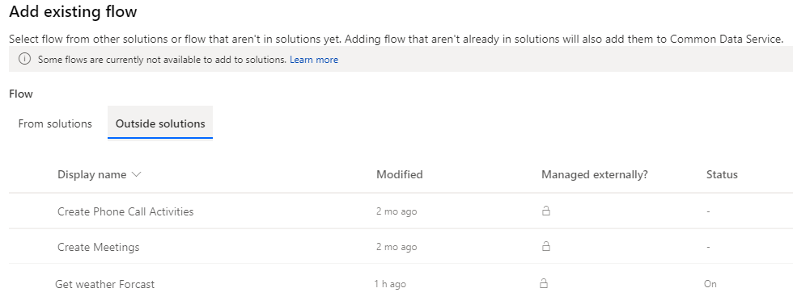
Leveraging a flow as an action
The flow must be moved to the environment it will be used in through solutions
Solution can be created in the Power Automate interface
Select Add Existing > Flow
Select the Flow from the Outside Solutions list

Slide 29
Lab
You will be creating a bot for a company that provides inflatable equipment for events such as birthday parties and corporate events. While most customer inquiries such as placing and cancelling orders must be done by agents, the company would like to use a bot to handle much of the routing.
Lab 10.1: Build a chatbot

Slide 30
Summary
With customers demanding more personalized and efficient customer service experiences, organizations are turning to bots.
Introducing bots, explaining where they are being used, and providing an overview of how Power Virtual Agents can be used to create bots.
Examining how to work with and create bots in different environments to tailor the bot content that is being used based on factors such as teams, regions, or other factors.
Reviewing the process for creating a bot and how to work with the Power Virtual Agents user interface.
Explaining what topics are, the different types that are available, and how they are used as part of a bot.
Examining the tools that are available to assist you with testing your bot.
Reviewing the process for publishing a bot so that it can be made available across multiple channels and describing the analytics that are available when the bot is published.

Slide 31
close

